Slide 1
E-retail factors for customer activation and retention: A case study from Indian e-commerce customers
To study factors that guarantee the success of online store. A comprehensive review of the literature, theories and models have been carried out to propose the models for customer activation and customer retention

Slide 2
Five major factors that contributed to the success of an e-commerce store
Service quality
System quality
Information quality
Trust quality
Net benefits

Slide 3
Analyzing Service factors which are responsible for E commerce success
Features related to service quality are—
Responsiveness, availability of several communication channels (email, online rep, twitter, phone etc.)
Shopping online is convenient and flexible
Return and replacement policy of the e-tailer is important for purchase decision
You feel gratification shopping on your favorite e-tailer

Slide 4
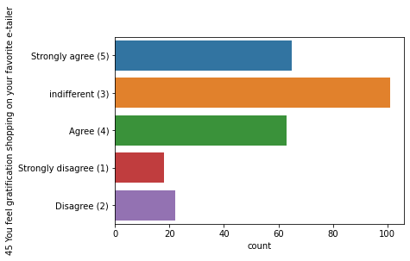
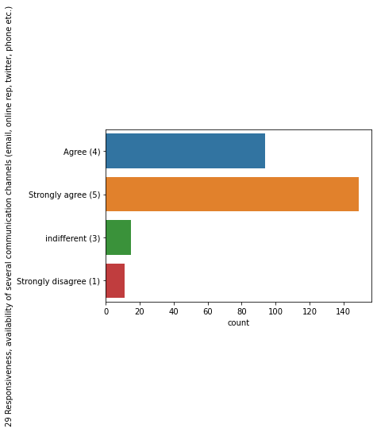
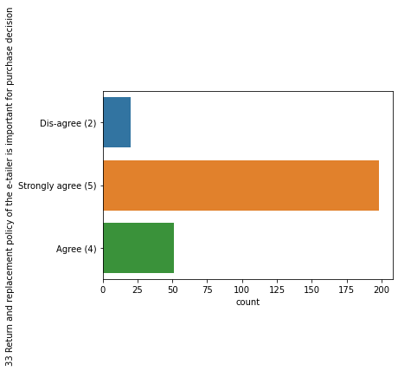
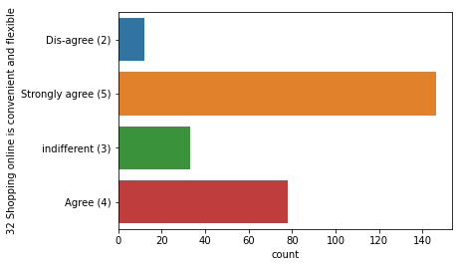
Notes:
Gratification

Slide 5
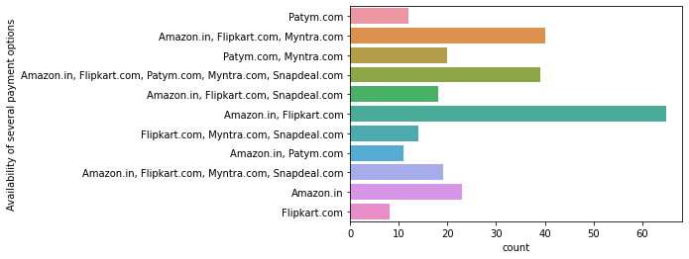
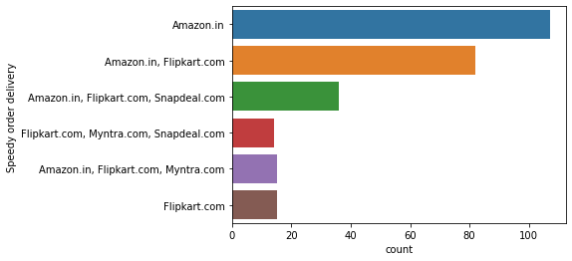
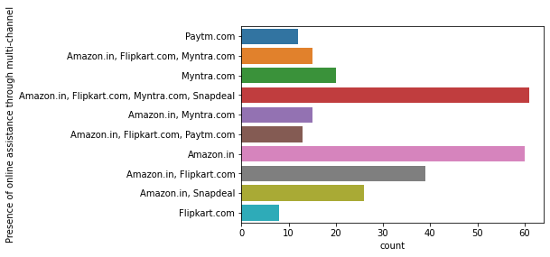
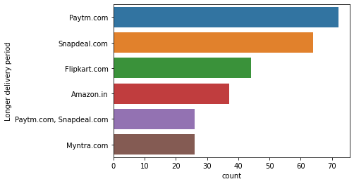

Slide 6
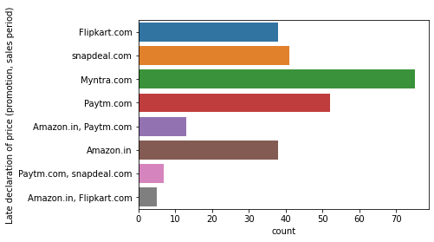
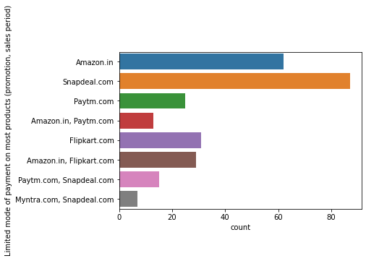

Slide 7
Analysis of service factors
From column 29,32,33 it is clear that max customers are strongly agree on Responsiveness availability,Shopping online is convenient and flexible and Return and replacement policy for purchase decision
from col. 45 customers have indiffernt views on feeling gratification shopping on your favorite e-tailer
from graph it is infered that max customer says that Amazon and flipkart has several payment option,snapdeal has limited mode of payment.
Amazon has the fastest delivery system,amazon flipkart myntra & snapdeal have presence of online assistance through multiple channel.
Paytm has the longest delivery period

Slide 8
System Quality
Features related to service quality are—
Ease of navigation in website
Loading and processing speed
User friendly Interface of the website
Convenient Payment methods
User derive satisfaction while shopping on a good quality website or application

Slide 9
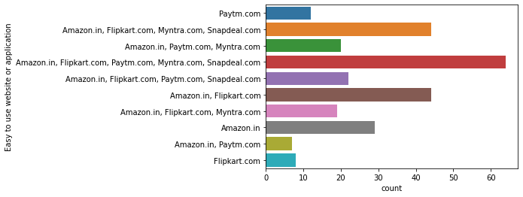
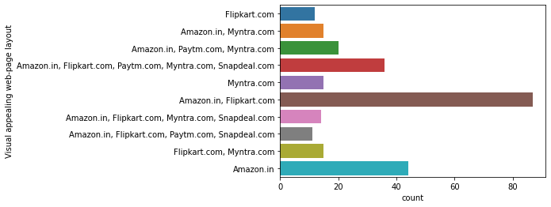
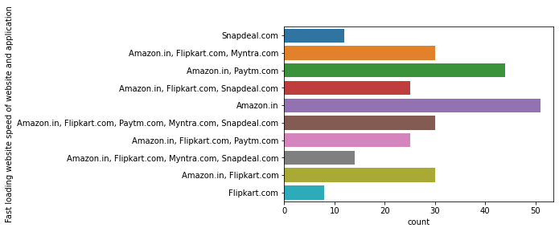

Slide 10
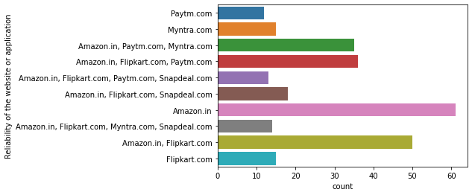
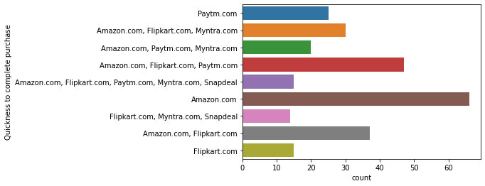
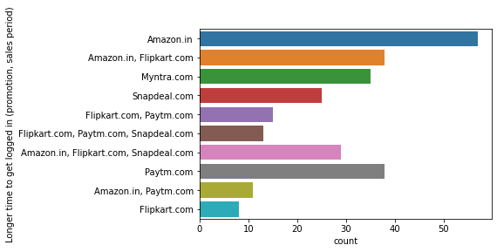

Slide 11
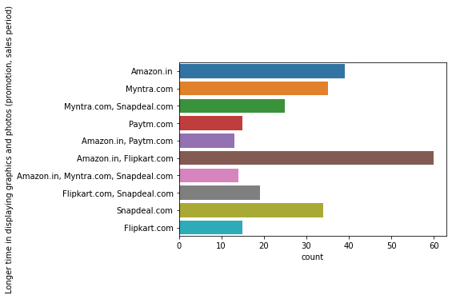
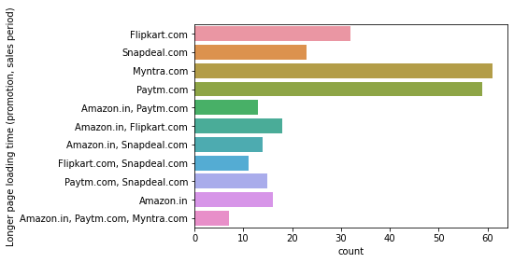

Slide 12
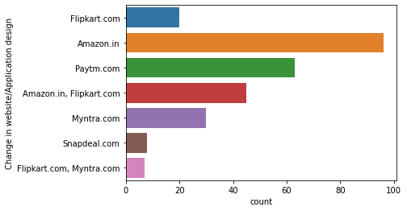
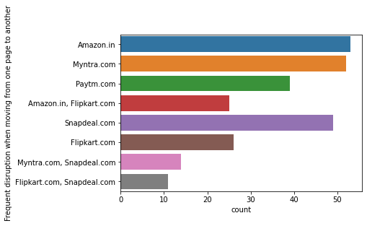
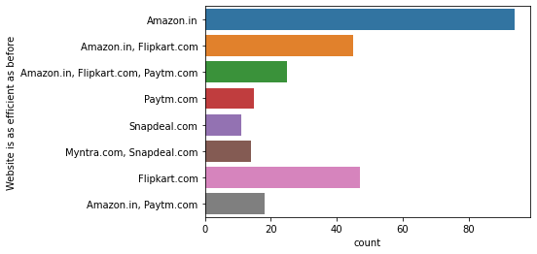

Slide 13
Analysis of System factors
In system quality on most of the parameter max customer are strongly agreed or agreed on ease of navigation ,loading processing,ser friendly Interface,Convenient Payment methods etc
max customer says amazon and flipkart have visual appealing web page
Amazon has the fastest loading speed of website,reliability,quickness to complete purchas,change in website design,website efficient as before.
But amazon has longer time to get logged in.Amazon & Flipkart takes longer time in displaying photos and graphics
Myntra and paytm have longer page loading time

Slide 14
Information Quality
Features related to service quality are—
The content on the website must be easy to read and understand
Information on similar product to the one highlighted is important for product comparison
Complete information on listed seller and product being offered is important for purchase decision.
All relevant information on listed products must be stated clearly
Displaying quality Information on the website improves satisfaction of customers
Provision of complete and relevant product information

Slide 15
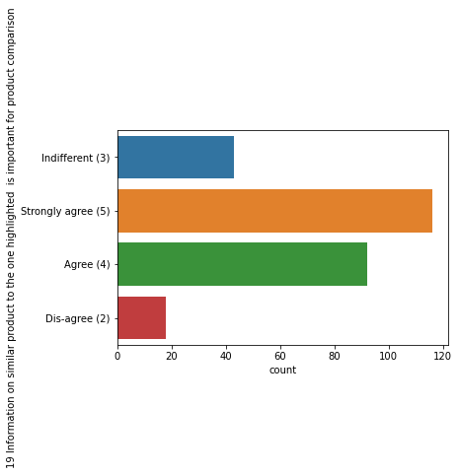
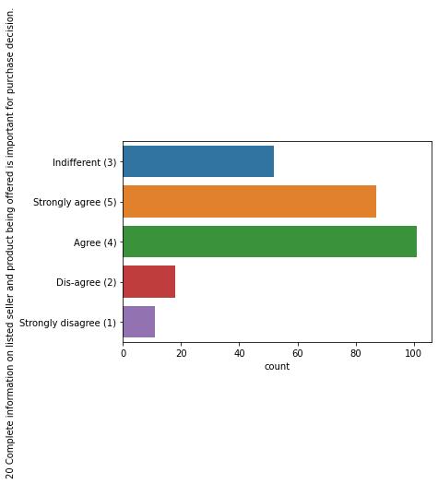

Slide 16
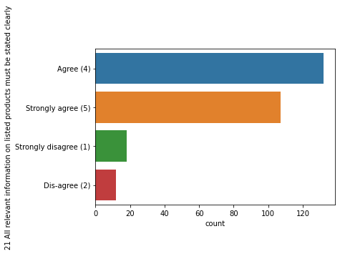
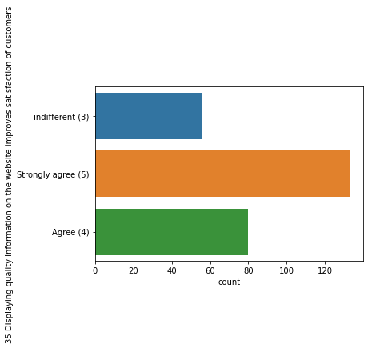

Slide 17
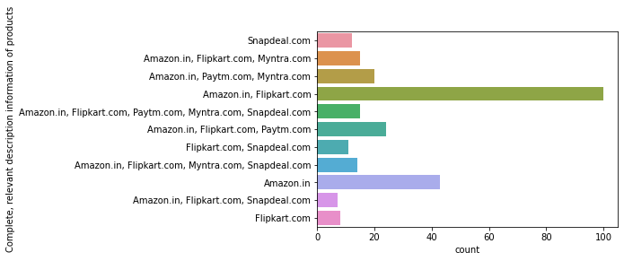
Notes:
`33F

Slide 18
Analysis of Information factors
Max customer agree or strongly on the content on the website must be easy to read and understand ,information on listed products must be stated clearly, Displaying quality Information, Complete information on listed seller and product.
Amazon and flipkart have complete,relevant description information of products.

Slide 19
Trust factors
Features related to service quality are—
Trust that the online retail store will fulfill its part of the transaction at the stipulated time
Empathy (readiness to assist with queries) towards the customers
Being able to guarantee the privacy of the customer
User satisfaction cannot exist without trust

Slide 20
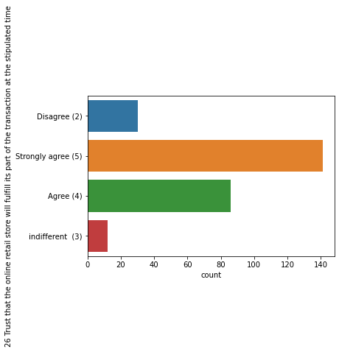
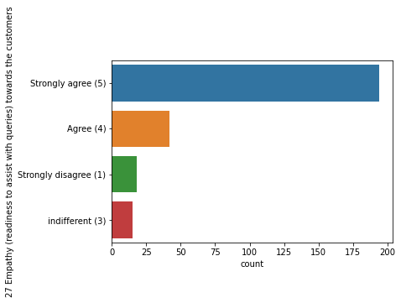
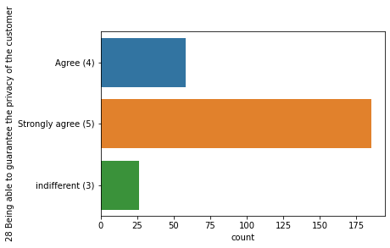
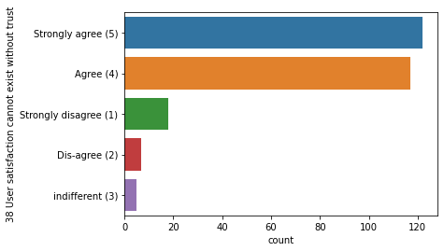

Slide 21
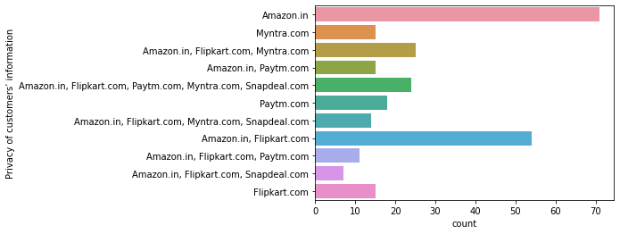
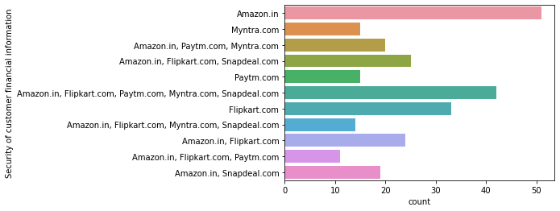
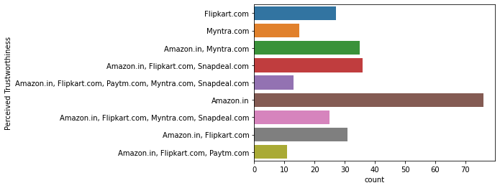

Slide 22
Hedonistic & Utilitarian values
Hedonistic values are combination of certain values which are follows—
Gratification
Role
Best deal
Social
Adventure
Utilitarian values are combination of certain values which are follows—
Product offerings
Convenience
Product Information
Monetary Savings

Slide 23
Analysis of Information factors
Amazon maintain highest privacy of customer information also it maintain highest security of customer financial information
Amazon perceived highest trustworthiness and Myntra has low trustworthiness.

Slide 24
Net Benefit
Features related to service quality are—
Online shopping gives monetary benefit and discounts
Gaining access to loyalty programs is a benefit of shopping online
Net Benefit derived from shopping online can lead to users satisfaction
Monetary savings

Slide 25
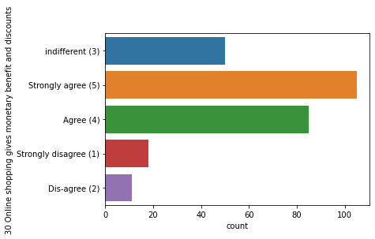
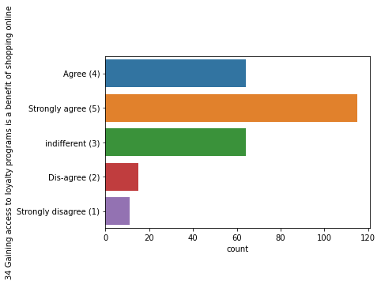
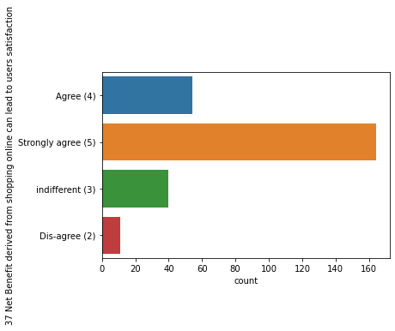
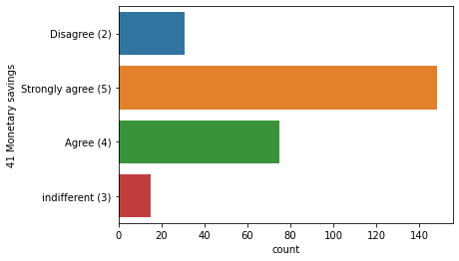

Slide 26
Repeat Purchase Intention
As per research there are certain factors which are responsible for repeat purchase in online shopping. These factors are categorizes into utilitarian value and hedonistic values.
Combination of both the values results in repeat order of customers

Slide 27
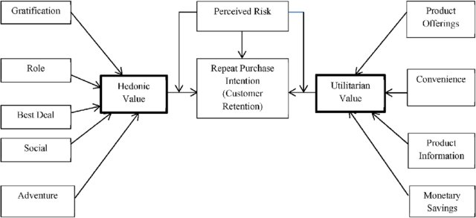

Slide 28
Features related to Utilitarian values in dataset
The content on the website must be easy to read and understand
Information on similar product to the one highlighted is important for product comparison
Complete information on listed seller and product being offered is important for purchase decision.
All relevant information on listed products must be stated clearly
Convenient Payment methods
Online shopping gives monetary benefit and discounts
Shopping online is convenient and flexible
Displaying quality Information on the website improves satisfaction of customers
Offering a wide variety of listed product in several category
Provision of complete and relevant product information
Monetary savings
The Convenience of patronizing the online retailer
Easy to use website or application
Wild variety of product on offer
Complete, relevant description information of products
Availability of several payment options

Slide 29
Features related to Hedonistic value in dataset
You feel gratification shopping on your favorite e-tailer
Shopping on the website helps you fulfill certain roles
Online shopping gives monetary benefit and discounts
Offering a wide variety of listed product in several category
Shopping on your preferred e-tailer enhances your social status
Shopping on the website gives you the sense of adventure
Which of the Indian online retailer would you recommend to a friend?

Slide 30
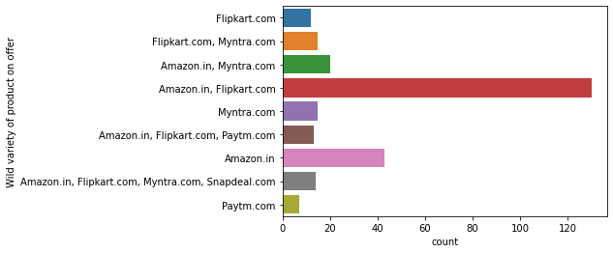
Utilitarian graph

Slide 32
Analysis of Utilitarian value
amazon,flipkart,paytm,myntra,snapdeal are easy to use in website and application
amazon and flipkart have wild variety of product on offer,they also have complete relevant description information of products.They have availability of several payment options

Slide 33
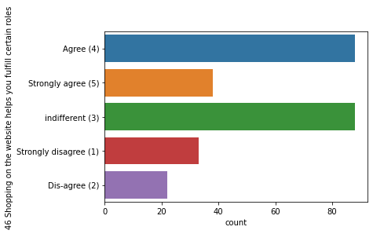
Hedonic Graph

Slide 34
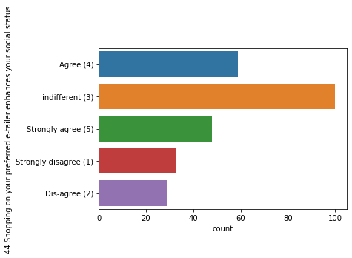
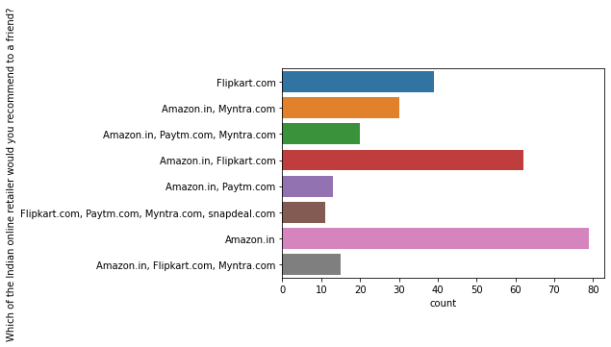

Slide 35
Analysis of Hedonic value
Max customer has indifferent view on shopping on your preferred e-tailer enhances your social status
Max customer says that would recommend Amazon to their friend.

Slide 36
Thank you

